Slide 1
Maharaja Agrasen Institute of Technology ETCS 211 Computer Graphics & Multimedia UNIT 1
Window to viewport transformation

Slide 2
Window to viewport transformation
Window port
Viewport
Window to Viewport mapping is required
Some transformations are required
Transformation can Translation, rotation, scaling and shearing

Slide 3
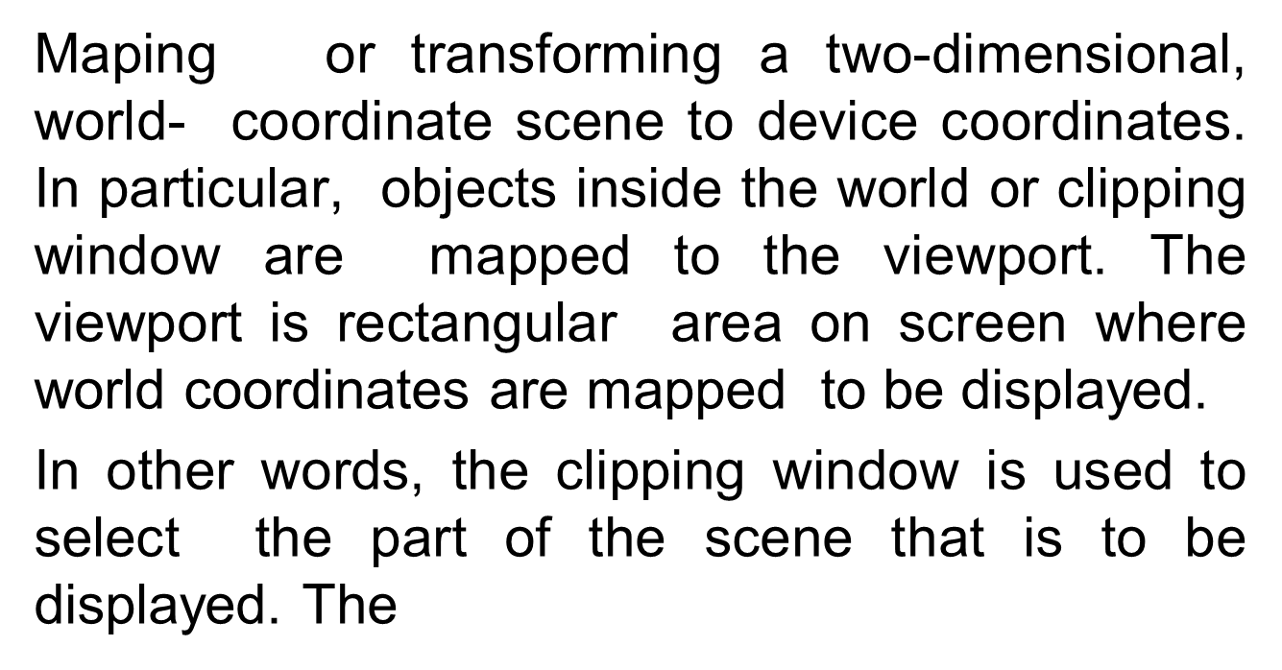
Window to viewport transformation
•
Window-to-Viewport mapping is the process of
viewport is used to display selected portion of window on the output device.

Slide 5
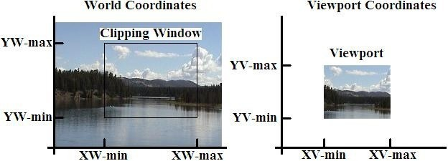
Window to viewport transformation

Slide 6
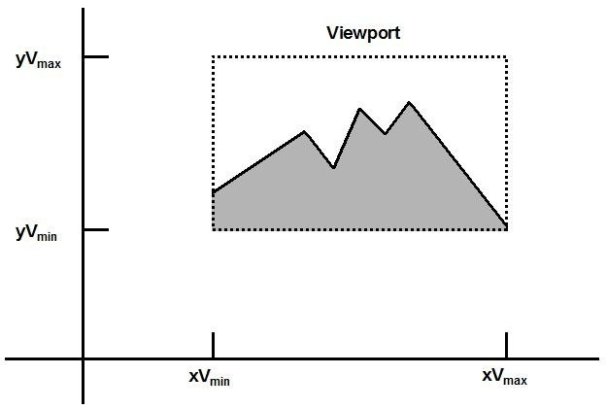
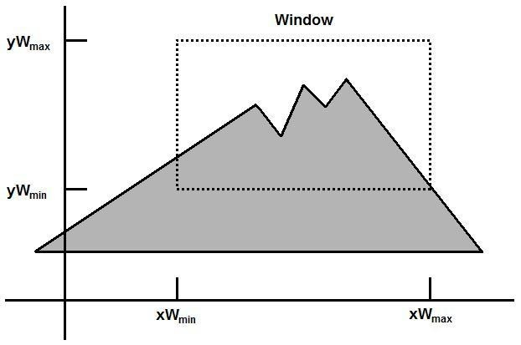
Window to viewport transformation
Window port: A world coordinate area selected for display.
View port: This is a rectangular region of the screen which is selected for displaying the object. In other words we can say that view port is part of computer screen.
Window to Viewport Mapping- Mapping of a part of a world coordinate scene to device coordinate is referred to as a viewing transformation.
Window to viewport transformation requires more than one transformation.
•

Slide 7
Concept of window to viewport transformation
•
It may be possible that size of viewport is smaller than size of window or greater than size of window.
In this case we have to expand or decrease size of window according to the size of viewport.
In this concept same mapping is required to convert size of window in size of view port.
Some mathematical computations are required to map window and viewport.
•
•
•

Slide 8
Window to Viewport Mapping
(wxmax, wymax)
(vxmax, vymax)
(x, y)
(u, v)
(wxmin,wymin)
(vxmin, vymin)
RM
[4]-7

Slide 9
Steps for window to viewport transformation
Step 1: Translate window towards origin To shift window towards origin, lower left or upper left corner of window will become (-).
Hence translation factor will become negative (-tx,-ty).
(-wxL,-wyL) – When origin is lower left corner of the screen.
(-wxL, -wyH)- When origin is upper left corner of window.

Slide 10
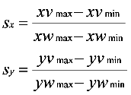
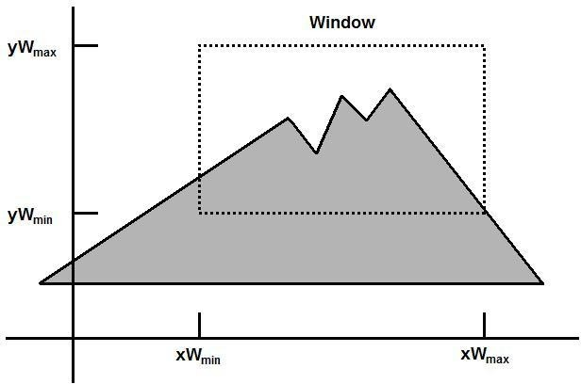
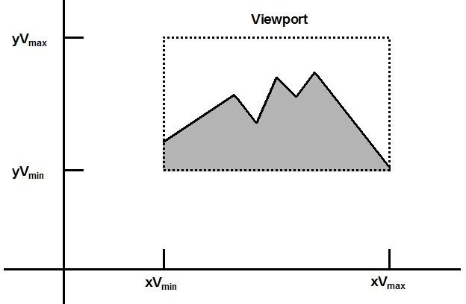
Steps for window to viewport transformation (cont..)
Step 2: Resize window to the size of view port.
To convert window size in to view port size following computation is required.

Slide 11
Steps for window to viewport transformation (cont..)
Step 3: Translate window (position of window must be same as position of view port.
If lower left corner of viewport is (0,0) we don’t need to take step 3 because window lower left corner is already shifted on origin after taking first step.
If lower left corner is not (0,0) we have to take translation factor (+).

Slide 12
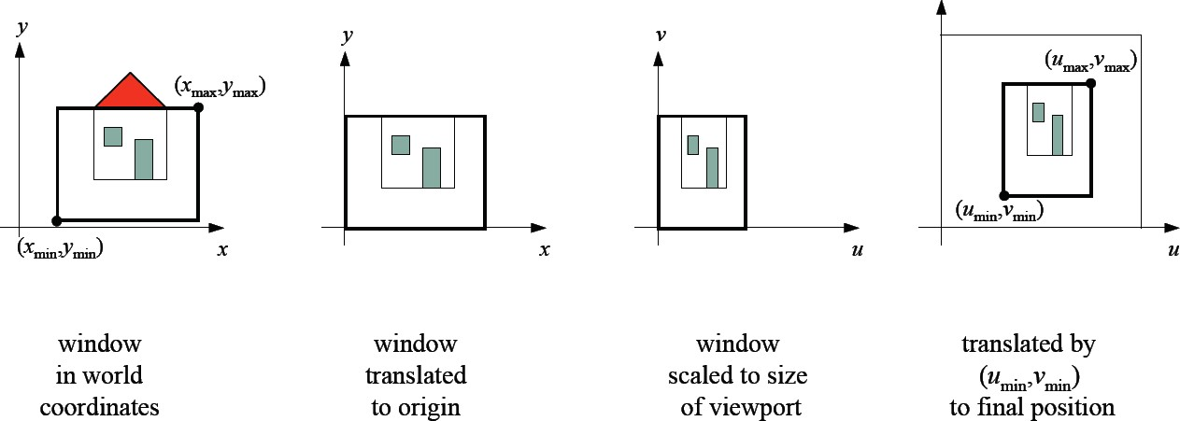
Steps for window to viewport transformation

Slide 13
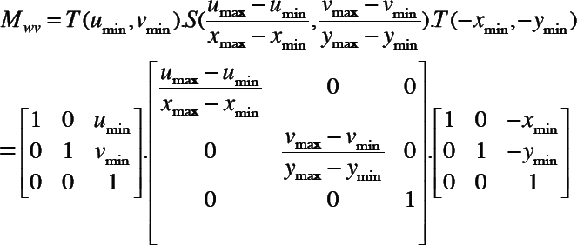
Steps for window to viewport transformation

Slide 14
Example
Let us consider an example of view transformation.
If our window has coordinates (10,10), (20,10), (20,20),
(10,20)
Let our viewport coordinates are (.5,.5), (1,.5),(1,1), (.5,1) Take step 1: Translate window to origin
In this case translation matrix will become
1
0
-10
0 0
1 0
-10 1
Take step 2: convert size of window to viewport size sx=(1-0.5)/(11-1)→ 0.5/10 → 0.05
sy=(1-0.5)/(11-1)→ 0.5/10→0.05
■
University of sulaimanyiah - Faculty of Physical and Basic Education - Computer Dep. 2012-2013
13

Slide 15
Example
so scaling transformation matrix will be
0.05 | 0 | 0
0 | 0.05 | 0
0 | 0 | 1
Step 3: Finally window to position of view port
1 0
0 1
0.5 0.5
0
0
1
University of sulaimanyiah - Faculty of Physical and Basic Education - Computer Dep. 2012-2013

Slide 16
Composition of transformations
⎡ 1 | 0 | 0⎤ ⎡.05 | 0 | 0⎤ ⎡ 1 | 0 | 0⎤
⎢ ₀ | 1 | ₀⎥ ⎢ ₀ | .05 | ₀⎥ ⎢ ₀ | 1 | ₀⎥ ⎥
⎢⎣−1 | −1 | ₁⎥⎦ ⎢_{⎣ 0} | 0 | 1⎥⎦ ⎢⎣.5 | .5 | ₁⎥⎦
⎢
⎥ ⎢
⎥ ⎢
Translation
Scaling
Translation
toward origin
further from origin

Slide 17
QUESTION
Window coordinates are (0,0), (2,0), (2,2), (0,2).
View port coordinates are (0,0), (4,0), (4,4), (0,4).
Find out relative position of coordinate (1,1) of window in viewport.
Calculate scaling factor for this transformation
Write down all three transformation matrix for this viewing transformation.

Slide 18
Formula to find out scaling factor
Sx= width of viewport / width of window Sy= height of viwport / height of window
Formula to find relative position xv = xvmin + (xw - xwmin)sx yv = yvmin + (yw - ywmin)sy

Slide 19
1. The object space or the space in which the application model is defined is called ____________ a) World co-ordinate system b) Screen co-ordinate system c) World window d) Interface window
2. What is the name of the space in which the image is displayed? a) World co-ordinate system b) Screen co-ordinate system c) World window d) Interface window
3,The scale factor of viewport transformation for x co-ordinate is ________ a) S_{x} = (sv_{max} – sv_{min})/ (sw_{max} – sw_{min}) b) S_{x} = (sv_{max} – sv_{min})/ (sw_{max} + sw_{min}) c) S_{x} = (sv_{min} – sv_{max})/ (sw_{max} – sw_{min}) d) S_{x} = (sv_{max} + sv_{min})/ (sw_{max} – sw_{min})

Slide 20
4.Panning is a technique in which users can change the size of the area to be viewed in order to see more detail or less detail. a) True b) False
5.The process of mapping a world window in World Coordinates to the Viewport is called Viewing transformation. a) True b) False
6.What is the rectangle in the world defining the region that is to be displayed? a) World co-ordinate system b) Screen co-ordinate system c) World window d) Interface window

